Slide 1
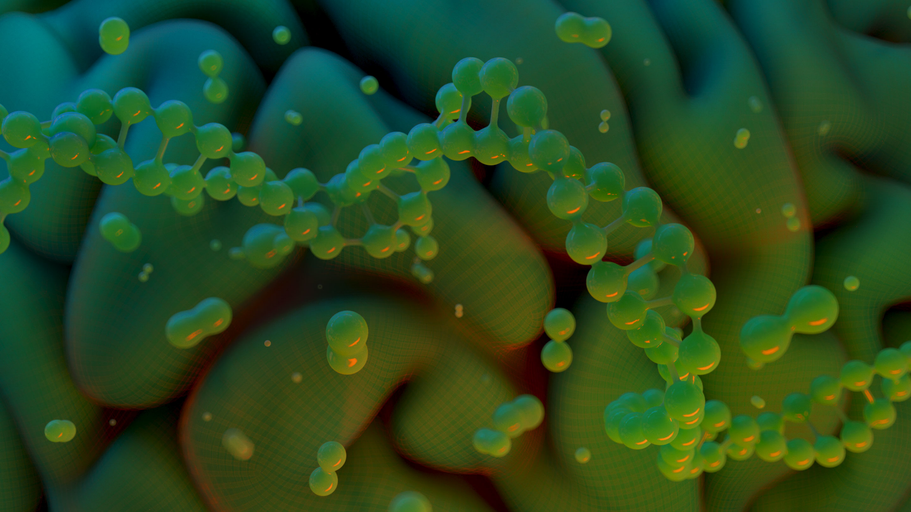
Elizabeth Scharrer
Corrales International School
2023-24
CIS Biology
Expectations
Student Responsibility
1. I will be positive.
2. I will be engaged.
3. I will show
respect .
4. I will participate.
5. My actions…my
consequences.
Lab Safety Rules:
(http://static.nsta.org/pdfs/SafetyInTheScienceClassroomLabAndField.pdf)
Course Description
This laboratory course is designed to provide information regarding the fundamental concepts of life and life processes. Topics covered include, but are not restricted to, cell structure and function, biochemistry, genetics, ecology, evolution, taxonomy, and certain aspects of earth science. Reading, writing, and speaking strategies are included in the course.
Lab Safety Rules:
https://www.uft.org/chapters/doe-chapters/lab-specialists/you-should-know/lab-safety-rules-students
(Continuous infraction of the Classroom Expectations and/or Safety will result in the following:
1. Lowered participation grade
2. Student/Teacher Conference
3. Parent/Teacher Conference
4. Administrative Action
Homework and Late Work
Homework is not busywork. Any homework assigned usually is work that was not finished in class. If you choose not to complete the assigned work, you are missing out on the opportunity to learn and grow. If a student misses class it is up to the student to go on Google classroom.
Late work for each quarter will not be accepted later than several days before the progress reports or report cards being released. I will inform parents and teachers when that date is.
scharrere@corralesis.org
505-344-9733
https://corralesis.org/teacher-page-elizabeth-scharrer/

Slide 2
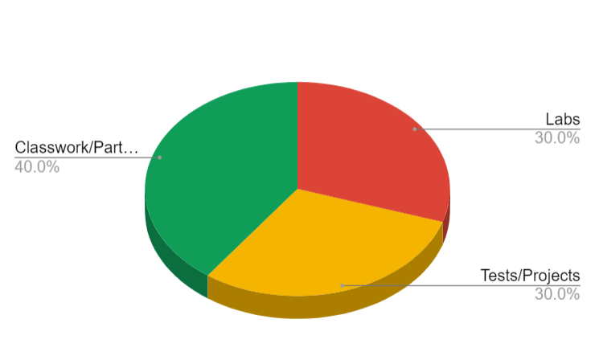
Elizabeth Scharrer
Corrales International School
2023-24
Classroom Policies, Procedures & Grading
A 90- 100%
Exceeds standard: demonstrates exceptional understanding of standards
B 80-89%
Mastery of standard: demonstrates a mastery level understanding of the standards
C 70-79%
Below the standard: shows some understanding, but is not meeting the standards
D 60-69%
Missing the standard: shows little to no understanding of the standards
F 00- 59%
Far below showing understanding of the standards
Absences: If you are absent, it is your responsibility to make up any necessary missed assignments. All assignments are posted on Google Classroom. It is up to the student to access this information.
Grade Value of Assessments and Assignments
Classwork/Partici- pation Grades 40%
⮚ Labs and Quizzes
30%
⮚ Tests and Projects 30%
Grading Weights
Google Classroom
Classroom Expectations & Consequences
This class will use Google Classroom to help you navigate course material..
Other resources that are helpful are as follows:
Textbooks and Outside Resources
https://www.youtube.com/@Bozemanscience1
https://www.khanacademy.org/science/biology
https://flexbooks.ck12.org/cbook/ck-12-biology-flexbook-2.0
Your teacher expects you to work hard and be nice. Meeting these classroom expectations and behaving appropriately in class helps to create a learning environment where you and your classmates feel welcome, safe, and respected.
If you choose to meet the classroom expectations, you will receive a positive consequence, such as praise from your teacher, classmates, school leadership; a positive note or phone call home; special privileges/activities, and awards.
If you choose not to meet the classroom expectations, you will receive a negative consequence, such as a verbal warning, a change of seat, a phone call home, a parent/guardian meeting, and for severe infractions of school rules, suspension.
https://corralesis.org/teacher-page-elizabeth-scharrer/
scharrere@corralesis.org
505-344-9733

Slide 3
