Slide 1
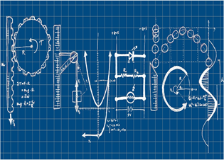
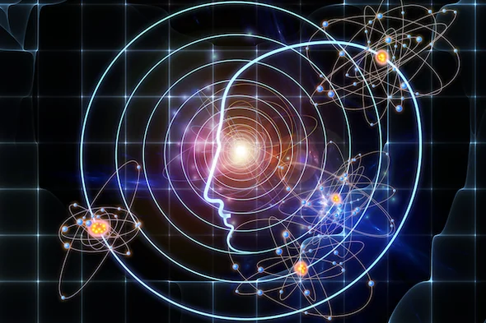
Elizabeth Scharrer Corrales International School 2023-24
Physics
Course Content: Topics such as Newtonian Mechanics, Thermodynamics, Waves, Optics, Electricity/Magnetism, Earth Science, Space and Nuclear Physics will be presented through both classroom instruction/demonstrations and student-led laboratory exercises.
Student Responsibilities
I will be positive.
I will be engaged.
I will show respect.
I will participate.
My actions…my consequences
Late work for each quarter will not be accepted later than several days before the progress reports or report cards being released. I will inform parents and teachers when that date is.
Lab Safety Rules:
https://www.uft.org/chapters/doe-chapters/lab-specialists/you-should-know/lab-safety-rules-students
(Continuous infraction of the Classroom Expectations and/or Safety will result in the following:
1. Lowered participation grade
2. Student/Teacher Conference
3. Parent/Teacher Conference
4. Administrative Action
scharrere@corralesis.org 505-344-9733 https://corralesis.org/teacher-page-elizabeth-scharrer/

Slide 2
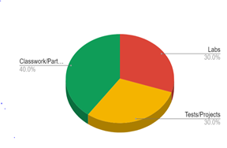
Elizabeth Scharrer Corrales International School 2023-24
Physics
A 90- 100%
Exceeds standard: demonstrates exceptional understanding of standards
B 80-89%
Mastery of standard: demonstrates a mastery level understanding of the standards
C 70-79%
Below the standard: shows some understanding, but is not meeting the standards
D 60-69%
Missing the standard: shows little to no understanding of the standards
F 00- 59%
Far below showing understanding of the standards
Grading Weights:
Classwork/Participation:40%
Labs:30%
Tests/Projects:30%
Textbook and Outside Resources
This class will use Google Classroom to help you navigate course material. Other resources that are helpful to you are as follows:
https://www.khanacademy.org/
https://www.youtube.com/watch?v=ZM8ECpBuQYE&list=PL8dPuuaLjXtN0ge7yDk_UA0ldZJdhwkoVw https://www.youtube.com/watch?v=ZM8ECpBuQYE&list=PL8dPuuaLjXtN0ge7yDk_UA0ldZJdhwkoVw
https://flexbooks.ck12.org/cbook/ck-12-physics-flexbook-2.0/section/1.1/primary/lesson/definition-of-physics-phy
Absences: If you are absent, it is your responsibility to make up any necessary missed assignments. See the Google Classroom for the day(s) you missed.

Slide 3
